Slide 2
Gender Proportion
General look at the data first!
How much did men and women participate in household work?
Who was more likely to be a researcher?

Slide 3
Gender Proportion - 1986
Value | Gender | Count | Percent
0 | Women | 5593 | 52.24
1 | Men | 4740 | 47.59
Total |  | N =10333 | 100

Slide 4
Were there really less men than women?
Sample: 10333
Test of Hypothesis: Mean = 0.5
Sample Mean = 0.458724
Sample Std. Dev. = 0.498318
Method Value Probability
t-statistic -8.419759 0.0000
We can conclude with 95% degree of confidence, that in 1995 there were less Men than Women living in Bulgaria!

Slide 5
Household Participation
Value | Chore Participation | Count | Percent
1 | No Participation | 435 | 4.21
2 | Just in few household activities | 464 | 4.49
3 | Only regular activities | 325 | 3.15
4 | All household work | 9109 | 88.15

Slide 6
Test Statistics | df | Value | Prob
Pearson X2 | 3 | 944.0482 | 0
Likelihood Ratio G2 | 3 | 1057.283 | 0

Slide 8
C | 3.85636 | 0.03427 | 112.5278 | 0
GENDER | -0.780983 | 0.05443 | -14.34831 | 0
EDU | 0.009945 | 0.00326 | 3.050166 | 0.0023
GENDER*EDU | 0.041618 | 0.005114 | 8.138609 | 0
R-squared | 0.125144 | Mean dependent var |  | 3.781
Adjusted R-squared | 0.124268 | S.D. dependent var |  | 0.682051
S.E. of regression | 0.638267 | Akaike info criterion |  | 1.941213
Sum squared resid | 1220.526 | Schwarz criterion |  | 1.949222
Log likelihood | -2907.82 | Hannan-Quinn criter. |  | 1.944094
F-statistic | 142.8552 | Durbin-Watson stat |  | 1.883577
Prob(F-statistic) | 0
Education helps men more with becoming conscientious towards household work, even though on average women tend to be more involved in such activities, no matter their education level.

Slide 9
Test Statistics | df | Value | Prob
Pearson X2 | 1 | 175.9486 | 0
Likelihood Ratio G2 | 1 | 175.9486 | 0
Statistically Significant

Slide 10
Test Statistics | df | Value | Prob
Pearson X2 | 1 | 1222.052 | 0
Likelihood Ratio G2 | 1 | 1282.072 | 0
Statistically Significant

Slide 11
Work conditions
Test Statistics |  | df | Value | Prob
Pearson X2 |  | 6 | 490.7624 | 0
Likelihood Ratio G2 |  | 6 | 493.3798 | 0
Men Stats
Mean | 3.362029
Median | 3
Maximum | 6
Minimum | 2
Std. Dev. | 1.469892
Skewness | 0.620616
Kurtosis | 1.923538
Jarque-Bera | 731.6577
Probability | 0
Sum | 21870
Sum Sq. Dev. | 14052.42
Observations | 6505
Women Stats
Mean | 3.693109
Median | 4
Maximum | 6
Minimum | 2
Std. Dev. | 1.491859
Skewness | 0.273774
Kurtosis | 1.638512
Jarque-Bera | 292.9602
Probability | 0
Sum | 12058
Sum Sq. Dev. | 7264.495
Observations | 3265
Overall, men work in worse conditions than women.

Slide 12
Variable | Coefficient | Std. Error | t-Statistic | Prob.
C | 4.194223 | 0.049939 | 83.98621 | 0
GENDER | -0.8943 | 0.066667 | -13.4145 | 0
DIPLOMA_GAP | -0.12661 | 0.010965 | -11.5467 | 0
DIPLOMA_GAP*GENDER | 0.045435 | 0.015478 | 2.935483 | 0.0033
R-squared | 0.077876 | Mean dependent var |  | 3.362029
Adjusted R-squared | 0.07745 | S.D. dependent var |  | 1.469892
S.E. of regression | 1.411823 | Akaike info criterion |  | 3.528255
Sum squared resid | 12958.08 | Schwarz criterion |  | 3.532425
Log likelihood | -11471.7 | Hannan-Quinn criter. |  | 3.529697
F-statistic | 183.0081 | Durbin-Watson stat |  | 1.662252
Prob(F-statistic) | 0
The diploma gap has a negative effect on working conditions, and it’s slightly weaker for men. Despite this difference, in any diploma gap category men’s working conditions are still more likely to be worse than women’s

Slide 13
Basic Demographics
 | coefficient | std. Error | z | P-value
TOWN | −0.249190 | 0.0134952 | −18.47 | 3.94E-76
AGE | −0.0128781 | 0.00099748 | −12.91 | 3.92E-38
GENDER | 0.998258 | 0.043957 | 22.71 | 3.58E-114
EDU
 | Uncentered R2 | 0.11408
 | Predicted | 1 | 0 |  | Accuracy | 70.09%
Actual | 0 | 6493 | 339 |  | Precision: | 68.85%
Actual | 1 | 2752 | 749 |  | Recall: | 21.39%
 |  |  |  |  | F1: | 32.86%

Slide 14
Basic Demographics
 | coefficient | std. Error | z | P-value
TOWN | −0.249190 | 0.0134952 | −18.47 | 3.94E-76
AGE | −0.0128781 | 0.00099748 | −12.91 | 3.92E-38
GENDER | 0.998258 | 0.043957 | 22.71 | 3.58E-114
EDU
 | Uncentered R2 | 0.11408
 | Predicted | 1 | 0 |  | Accuracy | 70.09%
Actual | 0 | 6493 | 339 |  | Precision: | 68.85%
Actual | 1 | 2752 | 749 |  | Recall: | 21.39%
 |  |  |  |  | F1: | 32.86%

Slide 15
Test Statistics | df | Value | Prob
Pearson X2 | 1 | 175.9486 | 0
Likelihood Ratio G2 | 1 | 175.9486 | 0
Statistically Significant

Slide 16
Basic Demographics
 | coefficient | std. Error | z | P-value | Meaning of coeff - Better
const | 2.4844 | 0.0848 | 29.3070 | 8.43E-189 | Baseline
TOWN | -0.5160 | 0.0168 | -30.6760 | 1.19E-206 | Lower (Sofia)
AGE | -0.0452 | 0.0015 | -30.6077 | 9.68E-206 | Lower (Younger)
GENDER | 0.7216 | 0.0478 | 15.0974 | 1.69E-51 | Higher (Male)
EDU | Uncomplete sample size
McFadden R2 | 0.1867 | Adjusted R2 | 0.1860 | Akaike criterion | 10769.7288
 | Predicted | 1 | 0 |  | Accuracy | 72.06%
Actual | 0 | 5762 | 1070 |  | Precision: | 61.15%
Actual | 1 | 1817 | 1684 |  | Recall: | 48.10%
 |  |  |  |  | F1: | 53.84%

Slide 17
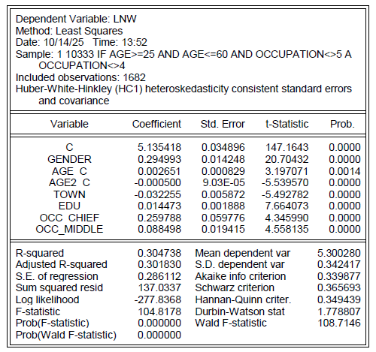

Slide 18
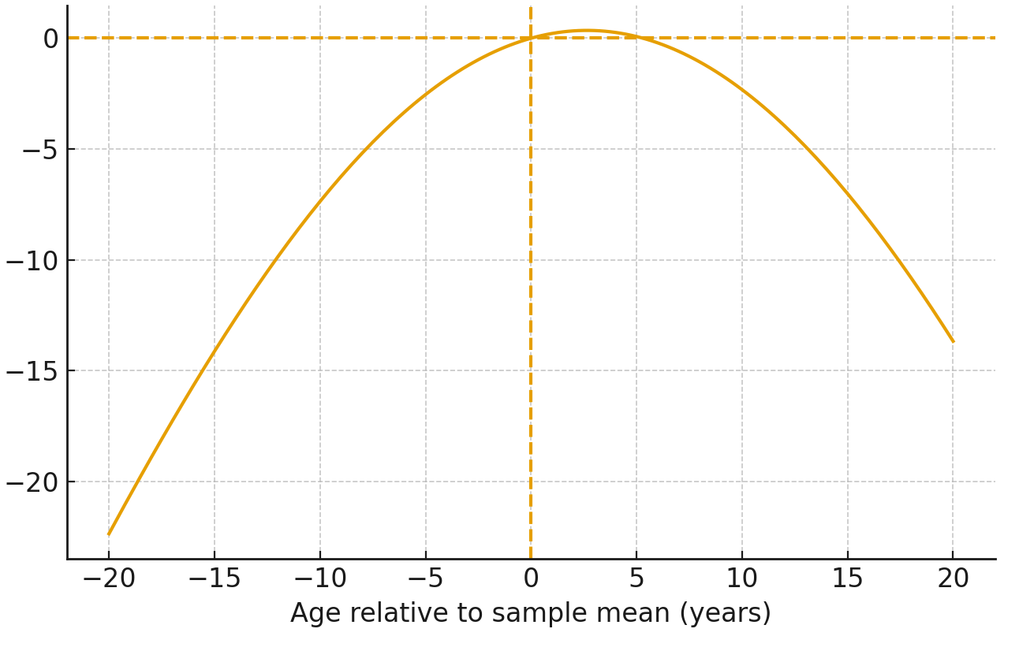

Slide 19
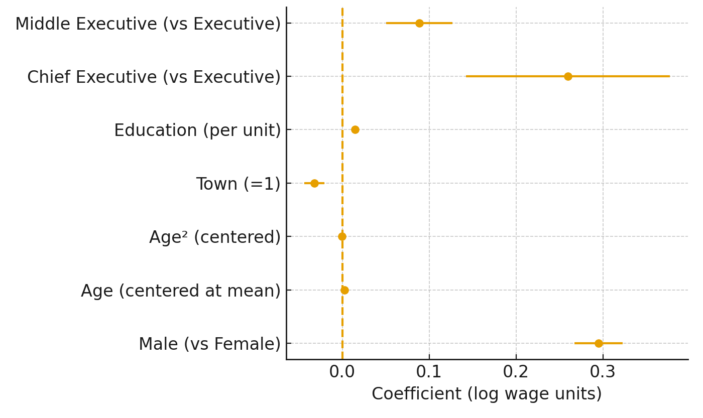

Slide 20
Do 88.15% really participate in All household work
Value | Household work Participation | Test Count | Test Percent
1 | No Participation | 734 | 7.11
2 | Just in few household activities | 783 | 7.58
3 | Only regular activities | 549 | 5.31
4 | All household work | 8266 | 80
Chi-squared test:
χ²=≈429.2
Critical value χ²₀.₉₅,3 ≈ 7.815
429.2 > 7.815
Reject the H₀: only 80% participate in
All household work

Slide 21
Were there really less men than women?
Sample: 10333
Test of Hypothesis: Mean = 0.5
Sample Mean = 0.458724
Sample Std. Dev. = 0.498318
Method Value Probability
t-statistic -8.419759 0.0000
We can conclude with 95% degree of confidence, that in 1995 there were less Men than Women living in Bulgaria!

